Slide 1
Covid19 forecasting
Nestor Rendon

Slide 2
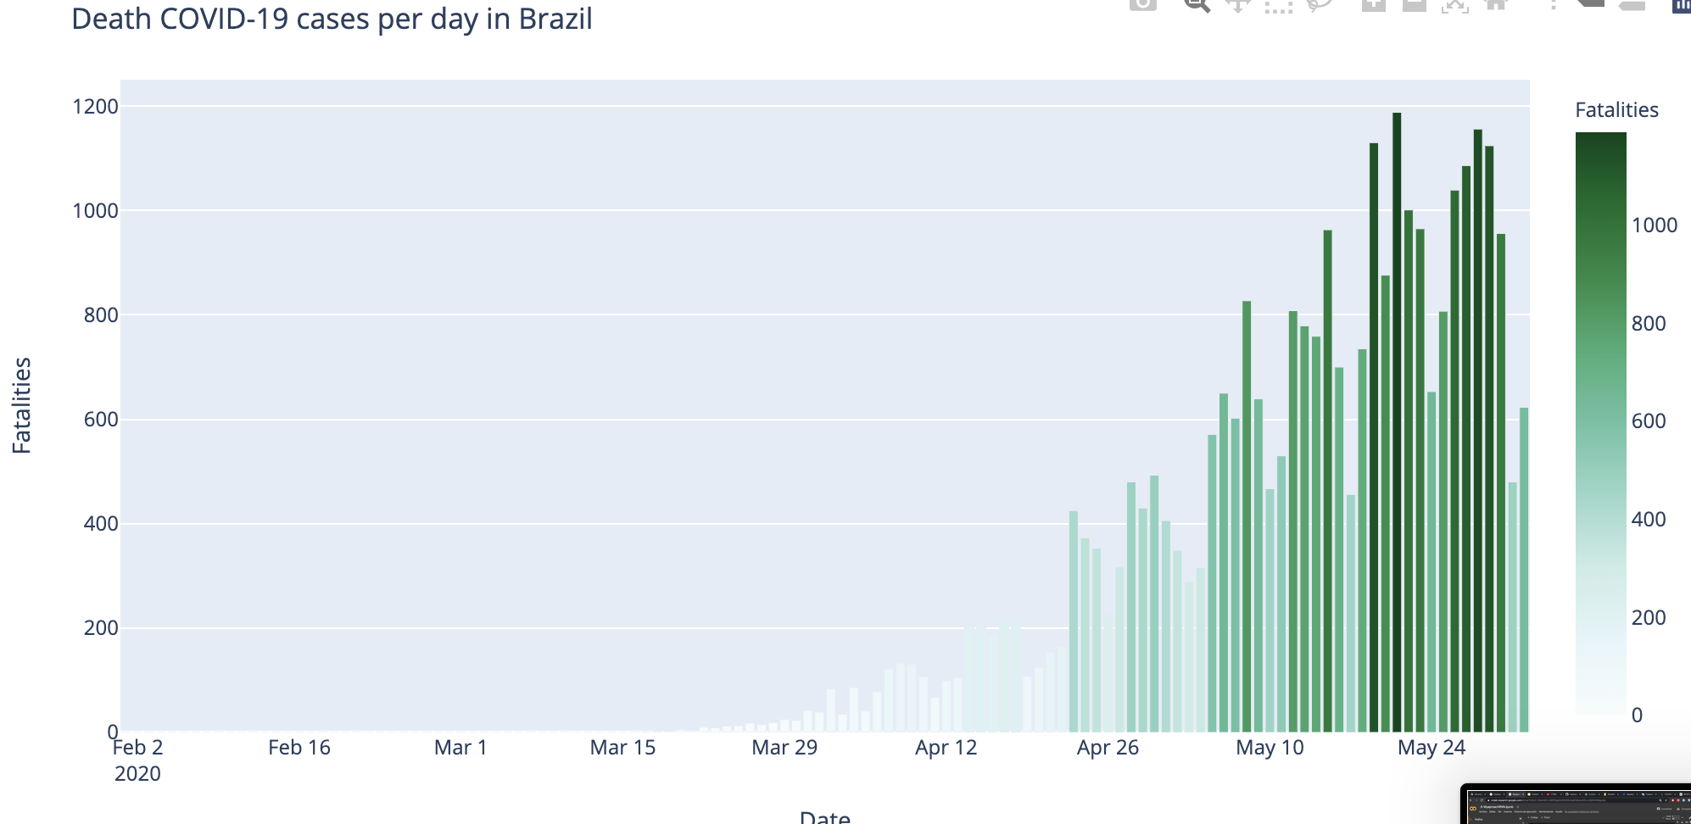
Information in general :
https://www.kaggle.com/roche-data-science-coalition/uncover?
Information related the economic of each country
https://data.worldbank.org/
World health organization
https://www.who.int/
Task: Predict Covid 19 confirmed cases and Fatalities.

Slide 3
Metodologic Flow
Databases
-coronavirus-disease-covid-19-statistics-and-research.
-regional-mobility.csv'
-total-covid-19-tests-performed-by-country
-worldbank.csv'
Data Exploration per countrie:
Statistics,
Gini Coefficient,
Correlation analysis
Static Variables per Countrie
Models
Conf. Cases and Fatalities
Province_State | Country_Region | Population | Weight | Date | Fatalities | ConfirmedCases | restrictions | quarantine | schools | hospibed | lung | total_pop | density | age_100+

Slide 4
Models
Test Model
outputs:
Fatalities
inputs: all variables
LSTM
Dropout
Dense
Confirmed cases
Final Model
Static Variables per Countrie
LSTM
LSTM
LSTM
Fatalities
Merge
Dropout
Dense
Conf. Cases and Fatalities
Dense
Dropout
Confirmed cases

Slide 5
Results
Baseline Kaggle Leaderboard: 0.27
https://www.kaggle.com/c/covid19-global-forecasting-week-5/leaderboard
Metric: RMSLE ,Look back=4, Timeahead=5, split train 60, val 20, test 10.
Cluster0='Bangladesh', 'Brazil', 'Indonesia', 'Nigeria', 'Pakistan', 'US'])]
Cluster1=Afghanistan', 'Angola', 'Antigua and Barbuda', 'Australia', 'Austria', 'Bahrain', 'Barbados', 'Belarus', 'Belgium', 'Belize', 'Benin', 'Bolivia', 'Bosnia and Herzegovina', 'Botswana', 'Bulgaria', 'Burkina Faso', 'Cambodia', 'Cameroon', 'Canada', 'Chile', 'Costa Rica', 'Croatia','
Cluster2=Argentina', 'Colombia', 'Egypt', 'France', 'Germany', 'Italy', 'Japan', 'Kenya', 'Mexico', 'Philippines', 'South Africa', 'Spain','United Kingdom', 'Vietnam'])]
Using K means
Brazil | Singapore' | Colombia'
0.87 | 0.45 | 0.45
Modelos/PAIS | Brazil | Singapore' | Colombia'
Model test | 0.74 | 0.44 | 0.5
Model Final | 0.87 | 0.45 | 0.43
Using all countries | 0.69 | 0.39 | 0.45
Kmeans with exploratory analysis
 | 0.72 | 1.57 | 0.45

Slide 6
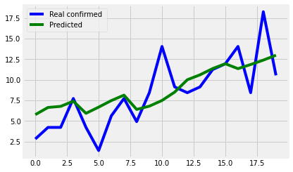
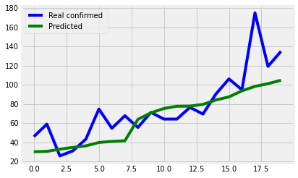
Using all variables
Fatalities Colombia
Singapore | Colombia | Brazil | Indonesia | India | Pakistan
0.57 | 1.37 | 0.38 | 0.21 | 0.2 | 0.66
0.39 | 0.41 | 0.68 | 0.5 | 0.28 | 0.6
CC
F
Fatalities India
Conclusions:
My hypothesis was that i can train similar countries with the same model i obtained 3 clusters, but for the model is better to train with all the countries.
The performance of my model is very naive, i consider that its necessary couple more not static variables
x
Weird: Different sources different db : https://covid19.who.int/region/amro/country/co
https://coronaviruscolombia.gov.co/Covid19/index.html
https://coronavirus.jhu.edu/map.html

